Slide 1
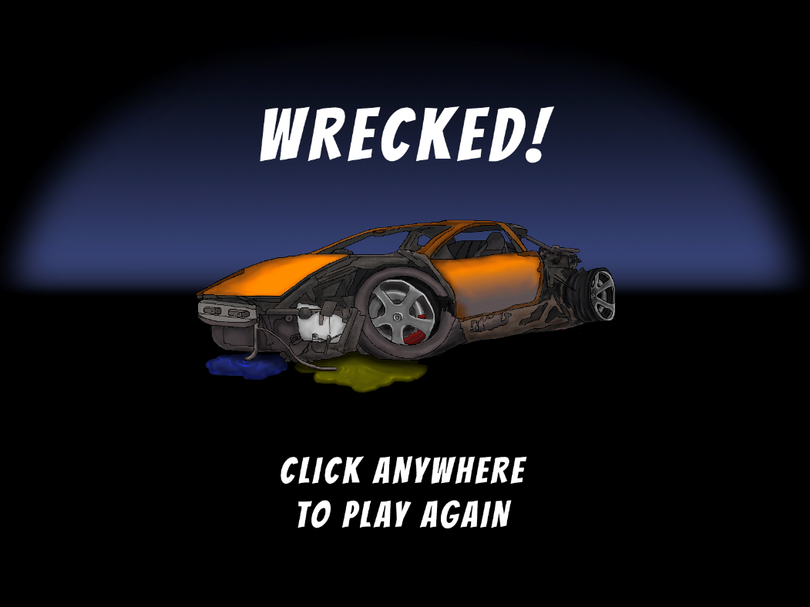
Little Racers
Pitch Date: June 22 , 2019 Week 10: 9/8/2019
Release Date: September 15, 2019 1 weeks to go!
Team Lead: Vince McKeown
21 contributors
421 total commits!

Slide 2
Updates
Vince McKeown
Level 2
Christer “McFunky Pants” Kaitila
Cars respawn at last checkpoints
Bug Fixes
Simon
Added Help options

Slide 3
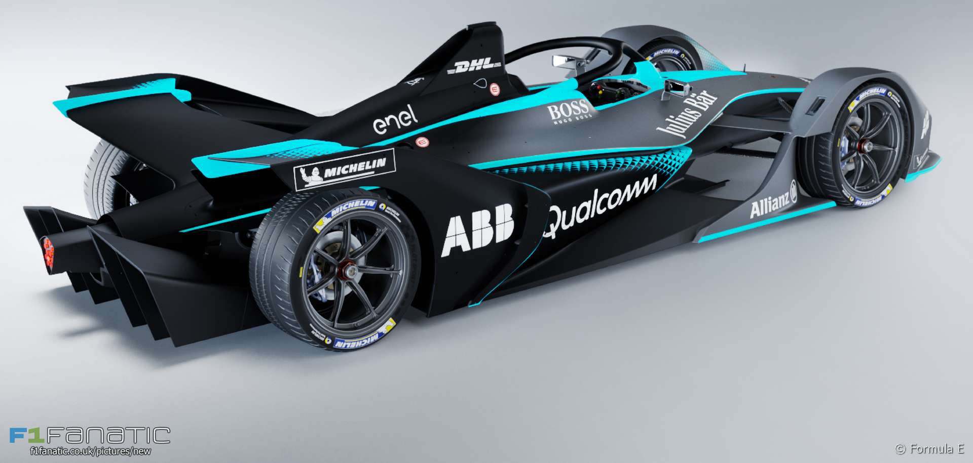
Demo
Cutover to Game

